Slide 1

Acknowledgement of Country
I would like to acknowledge the Bedegal people as the Traditional Custodians of this land. I would also like to pay my respects to the Elders, past and present, and extend that respect to other Aboriginal and Torres Strait Islanders who are present here today.
Notes:
Aboriginal and Torres Strait Islander people have made and are continuing to make extraordinary contributions to the scientific community and I think it likely that the future of sustainability and biodiversity here will depend on enabling and enacting Indigenous-driven solutions.

Slide 2
SCIF2001 – Workshop 2B
First Steps

Slide 3
Today's Plan
Navigating the Uncertainty of Science
What can go wrong in science?
Activity: Pick holes in a scientific plan!
2) Methods to deal with scientific uncertainty
- Backup Plans
- Proof of Concept
​- Milestone
Activity: Plan for your future project!

Slide 4
Science is uncertain
Authentic research is sometimes difficult because there are no clear answers, and you don’t know if what you’re doing will work.
That’s how science is – and learning to be a scientist involves learning to navigate the unknown.

Slide 5

Risk Identification and mitigation
While cool ideas are an important part of science, thinking about what can go wrong matters!
Identification of risks in science is the first step in mitigating those risks – and getting successful science.

Slide 6
Word cloud
Think about a scientific project (yours, or one you’ve read about).
What are or were some of the risks to that project?

Slide 7
What can go wrong?

Slide 8
Some Examples
Timeline issues!
Incorrect Assumptions!
Equipment Failure!
Bad Procedure!

Slide 9
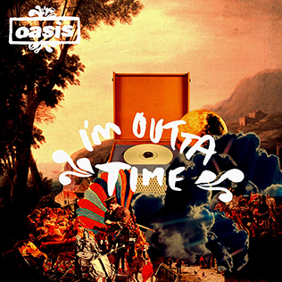
Time
Running out of time is a large risk in short-term projects.
Identify the parts that:
Have flow-on effects if delayed
Depend on external factors
Cannot be ‘compressed’ (i.e. you can’t pull an all-nighter to grow new cells, even if you could for analysis!)

Slide 10

Equipment Failure / Resource issues
Interfacing with reality exposes you to the whims of reality ☹. Stuff breaks, or doesn’t work, or needs calibration.
Consider:
Is there one machine or device that is vital for your project? Are there backups?
Do I need to make something early on, that later work depends on?

Slide 11
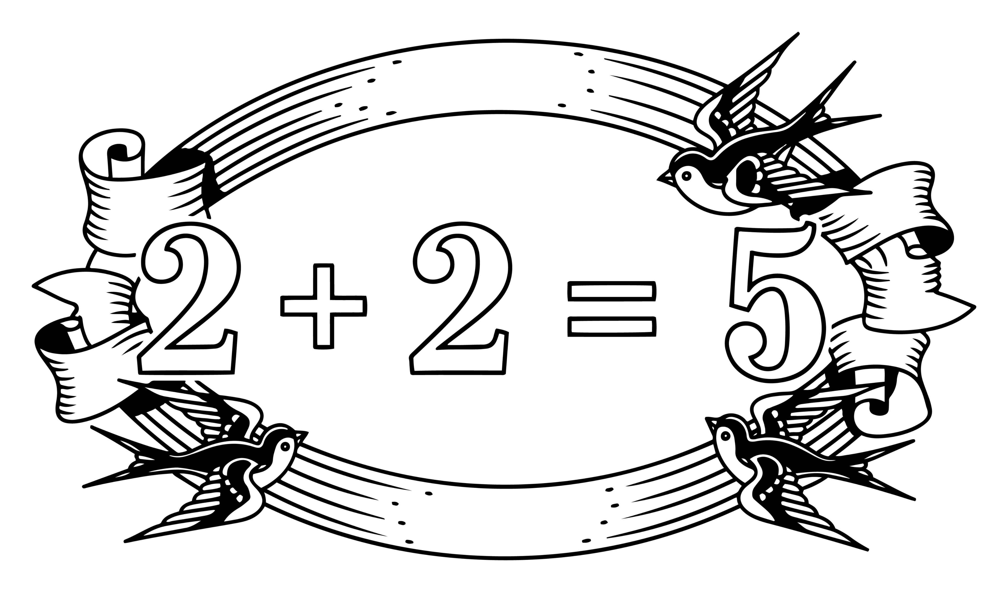
Incorrect assumptions
Sometimes you make guesses about how your experiment will evolve, or what the results will look like.
Consider:
If I got this assumption wrong, would my data still be valid?
Can I do a simpler experiment first to test that my assumptions are true?

Slide 12
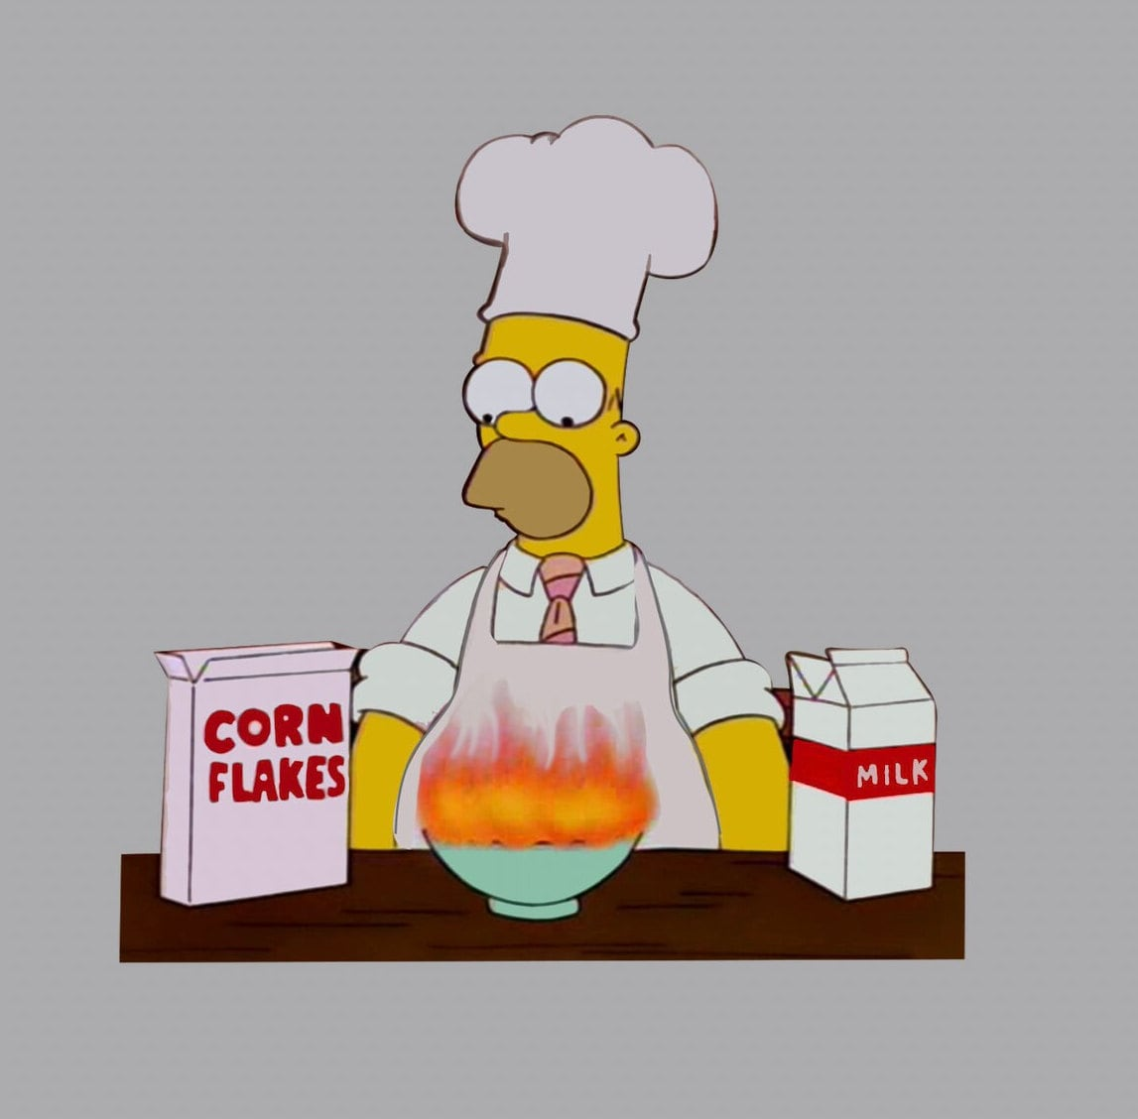
Bad procedure
If it’s your first time doing something, it’s really hard to know if you’re doing it right!
To make sure you don’t find out right at the end, consider;
Is there a known result that you can replicate to make sure you’re following correct procedure?
What would the early signs be of your experiment output not looking right?

Slide 13
Activity 1
In groups, or on your own, think about your research project.
What’s one risk to this project, based on what we’ve outlined?
(There’s a quiz question on this later!)

Slide 14
Navigating the Uncertainty of Research
How do you plan when the future is uncertain?

Slide 15

Strategies to use
You can never know the outcome of research before you begin – that’s why it’s research!
Good scientists don’t just hope it works out – they do their best to mitigate the uncertainty of their research.
Today we’ll learn about three methods:
Proof of Concept
Milestone Experiment
Backup Plan

Slide 16
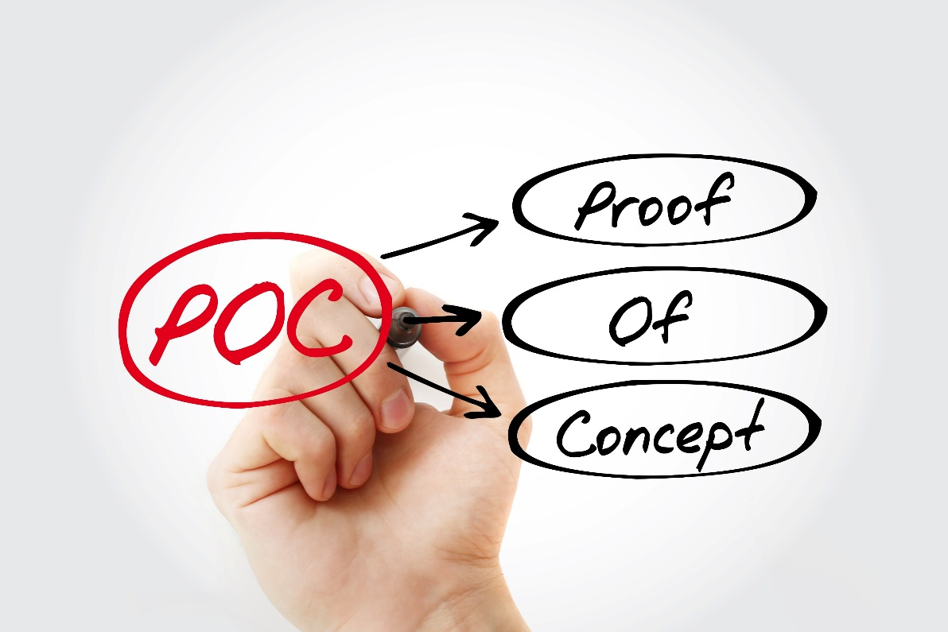
Proof of Concept
A proof of concept shows that your experiment might theoretically work out. If when planning your experiment, you (or someone) ask “is it even possible to do X” – then it’s time for a proof of concept!
A good proof of concept experiment:
Focuses on the most uncertain aspect of the experiment.
Can be conducted and verified more quickly than the real experiment.
Could be literature / calculative based!

Slide 17
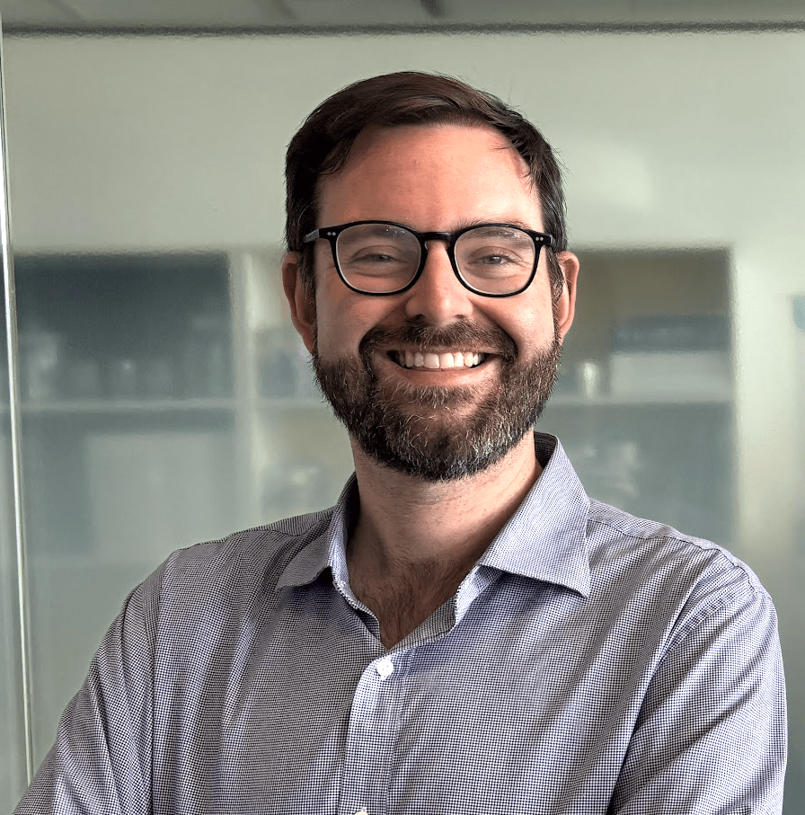
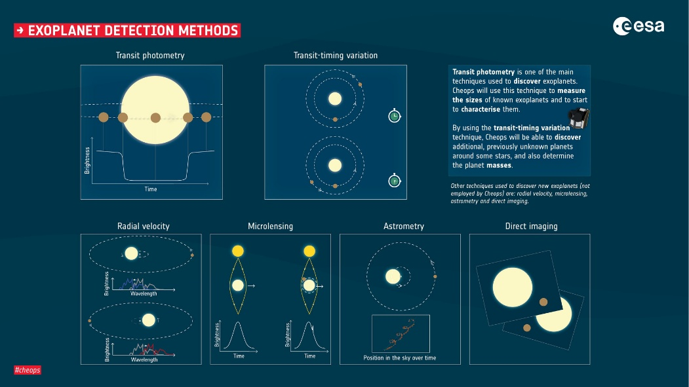
Proof of Concept example
Their proof of concept is to be able to look at a known system where a binary star exoplanet has been detected before using a different technique to demonstrate that they get the same result as that study.
In Ben’s research team, they are looking for exoplanets around binary stars.
They’re hunting for them by looking for the perturbations to the binary star orbit caused by the mass of the planet.

Slide 18
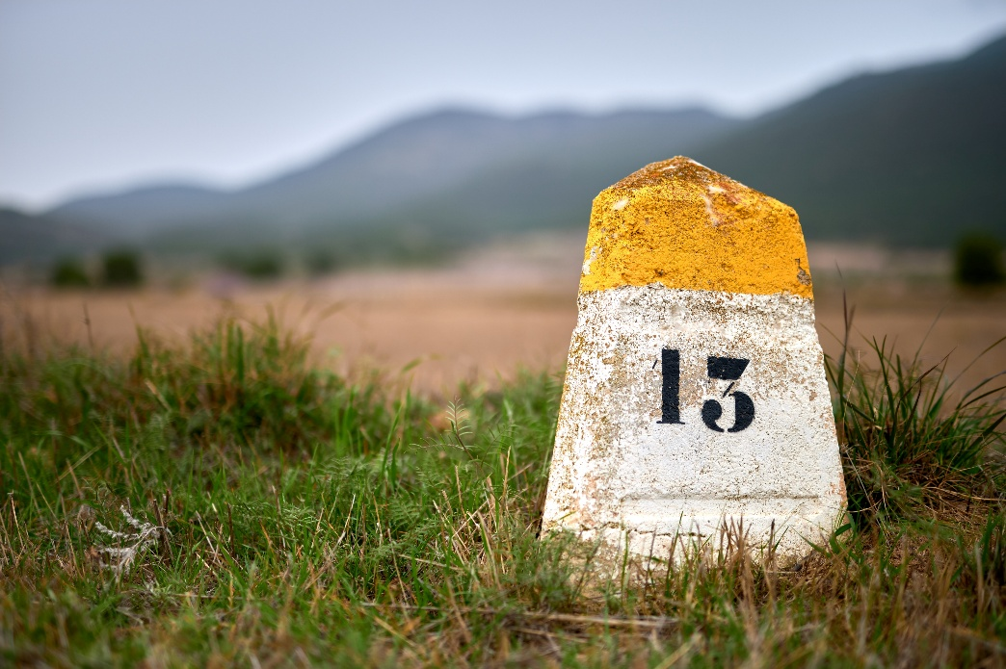
Milestone Experiment
A Milestone Experiment is an experiment using some of the same equipment / techniques as your ‘main’ experiment, but that is much simpler and has an easily verified answer.
You’d conduct a milestone experiment to:
Verify that key equipment work as expected.
Train yourself on a difficult experimental technique.

Slide 19
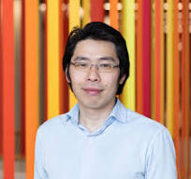
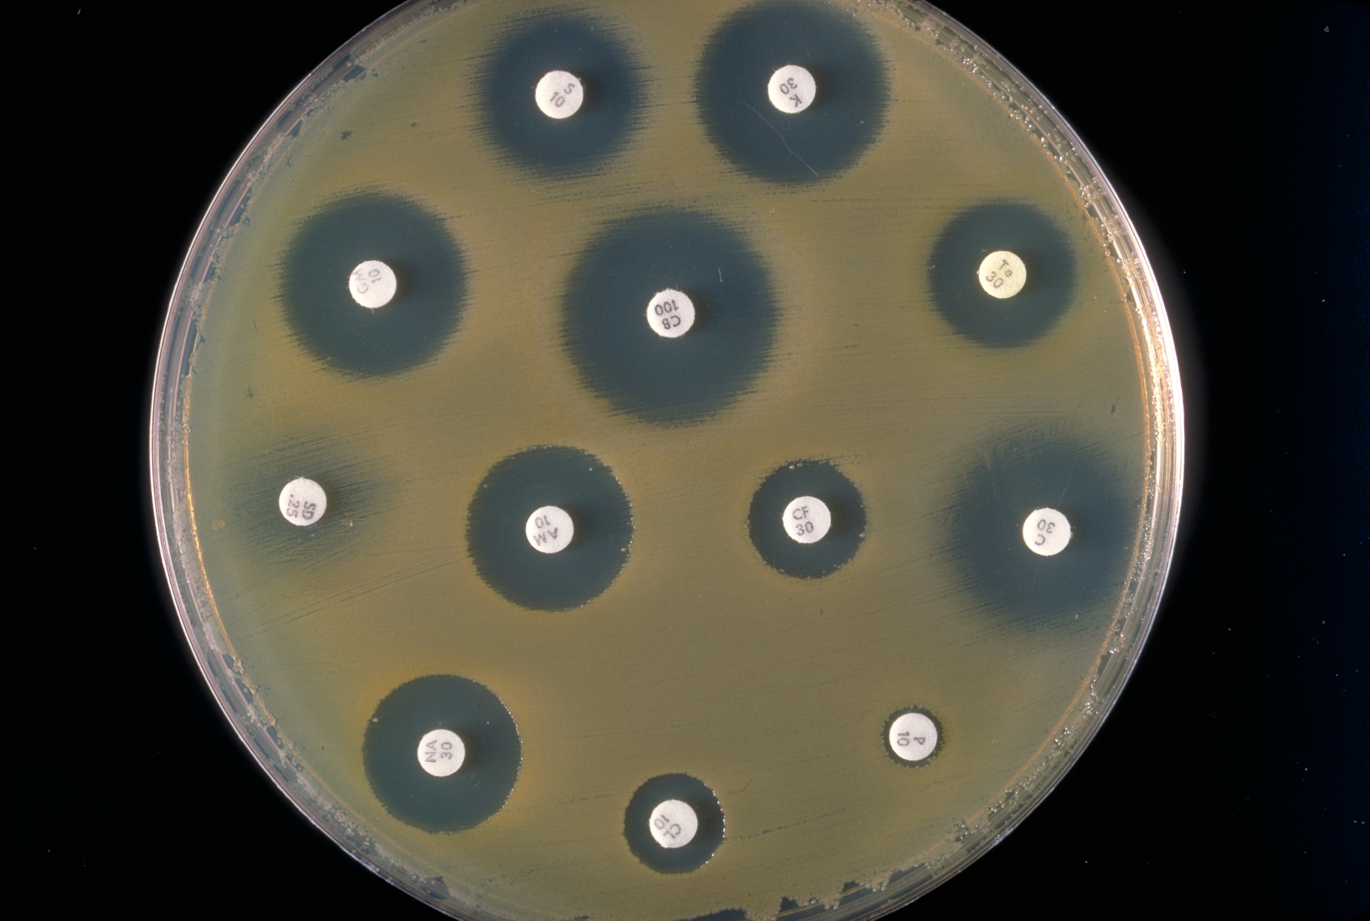
Milestone example
Gee’s microbial genetics course investigates the transfer of multidrug-resistant plasmids between different microbial species.
Screening for all resistance genes simultaneously is both economically impractical and energetically burdensome for the microbes, as expressing multiple resistance genes can strain cellular resources.
A more efficient approach is to begin with a simplified milestone experiment using a single antibiotic assay. Once plasmid transfer is confirmed through this initial screen, subsequent assays can be designed to detect additional resistance genes using more complex and targeted methods.

Slide 20
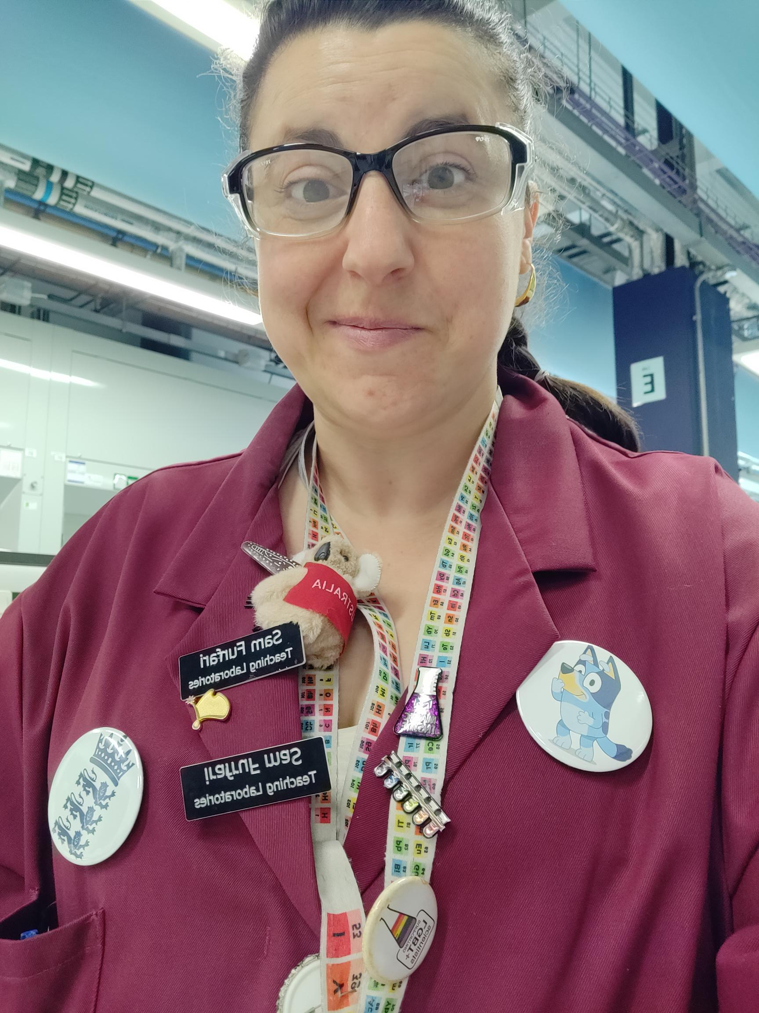
BACKUP PLaN example
One aspect of Sam's research is multi-component reactions (MCRs) provide a powerful platform for sustainable synthesis by combining three or more building blocks in a single step.
So, what happens if the reagents we are focusing on doesn’t actually work?
There are a couple of avenues we could explore:
  Test purity of all components (TLC, NMR, melting point)
  Vary reaction conditions (temperature, solvent, concentration) one at a time.
  Re-run a literature preparation to check fundamentals
  Swap to a simpler or more reliable building block if needed

Slide 21
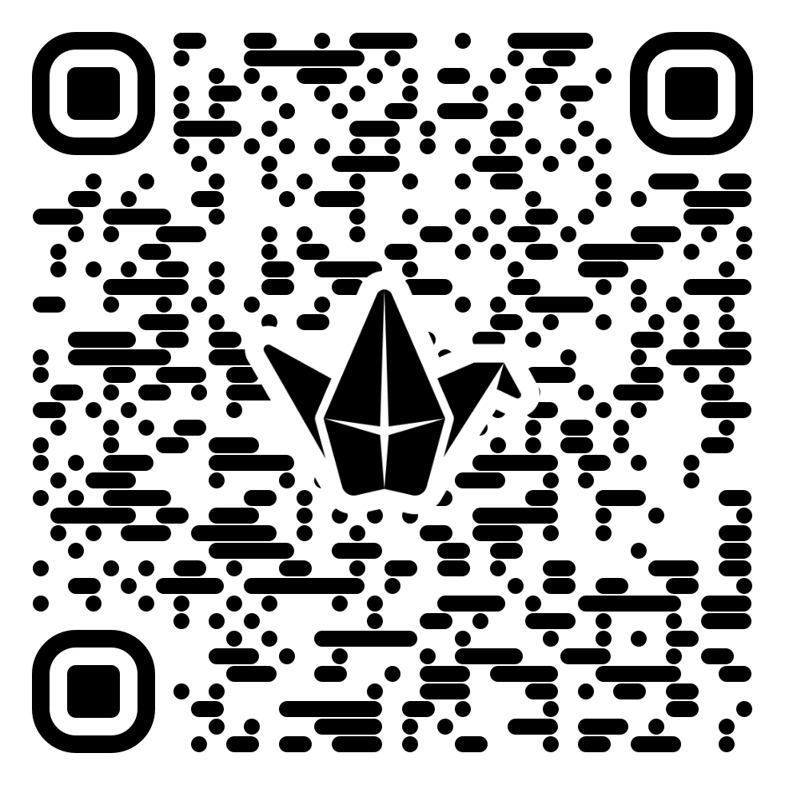
Activity 2: A backup or a proof of concept
Think about your planned research project. On your own, with a friend, try to think up any of;
A Backup Plan
A Proof of Concept
A Milestone Experiment

